Slide 1

Year 9 Business and Economics
Week 8

Slide 2




The Business Apprentice
My name is Sir Bago Sugar. I’ve been in the business since I was your age, when I began selling sweets to other children in my class.
I’m looking for an apprentice to help me run my multi-million dollar business empire.
Have you got what it takes?

Slide 3

The Business Apprentices
LEARNING INTENTIONS
During this project, you will:
Develop your creative thinking and enterprise skills.
Make decisions about products and advertising.
Work effectively as part of, and manage, a team.
Undertake research to help you to perform better.
Develop confidence when talking to an audience.
Invent a totally new product.

Slide 4
Score Chart
5 points for 1st place, 3 points for 2nd place, 1 point for 3rd place. (*) Double points round.
Team Name | Team building | Design | Advertising | Invention | Total

Slide 5


Lesson 1: Starting Out
Your teacher will organise you into groups.
3 – 4 team members works best, so you get lots of different opinions but the group is still small enough for everyone to be involved.
In this lesson, you will be…
Choosing a name for your business.
Participating in a team building activity with your team.

Slide 6


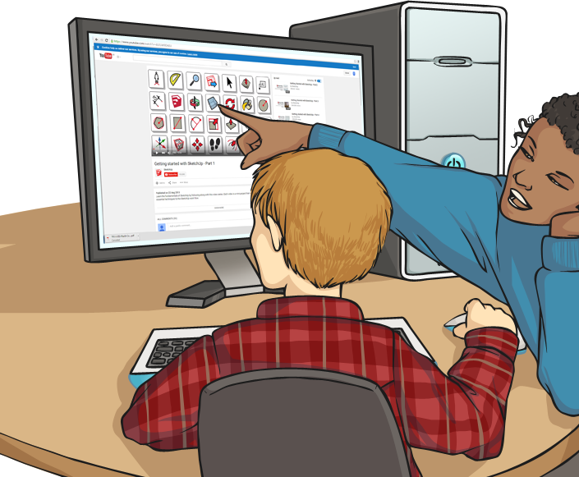
Research Links
Your first task is to think of a name.
Watch this video for tips about naming a
business (stop at 2 mins 50 secs).
These names were chosen by teams in a similar competition.
Take 5 minutes with your team to decide on a name that your team/company can use throughout this process.
Online stopwatch here
When all the names are finalised, the teacher will have final approval and add them to the scoresheet here.
Notes:
watch?v=cxeosIPTq8c (stop at 2mins 50 secs.)
Online – stop watch: https://www.online-stopwatch.com/countdown-clock/full-screen/

Slide 7
The Role of a Project Manager
For each task, your team will need a project manager. The project manager has ultimate responsibility for the success or failure of the task. Your team will need to swap the project manager for every task to ensure a fresh perspective.
A project manager’s duties will include:
Dividing up the team to decide who will work on which aspect of the task.
Getting the best out of everyone and making sure everyone is contributing to the success of the task.
Making decisions when the team is divided between the two possibilities.

Slide 8


Who will be Project Manager for the team building task?
You have 2 minutes to
DECIDE NOW.

Slide 9

Team Building Task
Success in the building task will count towards your team’s potential for winning points,
but even if you don’t win, the seeds of success could be sown here if teams establish a good working relationship.
Click to see the RULES.

Slide 10
Team Building Task
Task: Build the highest possible tower in 10 minutes using only newspaper.
Equipment: Only newspaper!
Rules: Only newspaper can be used – the highest free standing tower after 10 minutes is the winner!
Anyone who knocks down another team’s tower will lose 5 points
Your teacher will distribute newspapers and then begin the countdown timer Online stopwatch here

Slide 11
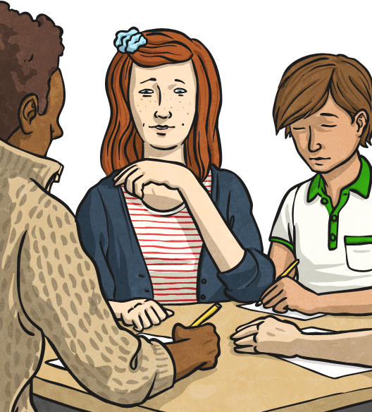
Working as Part of a Team - Reflection
What needs to happen in order for a team to work well together?
How do you know if a team is working well together?
What are the problems that could occur in your teams?
What strategies will you use if these problems occur?

Slide 12
Lesson 2: Design Task
Let’s get the ball rolling!
I have put your company in touch with another company who have just designed a new chocolate bar.
They want your company to design packaging and a slogan for the chocolate bar to be part of the marketing campaign.
Don’t let me down – the best one will win!

Slide 13
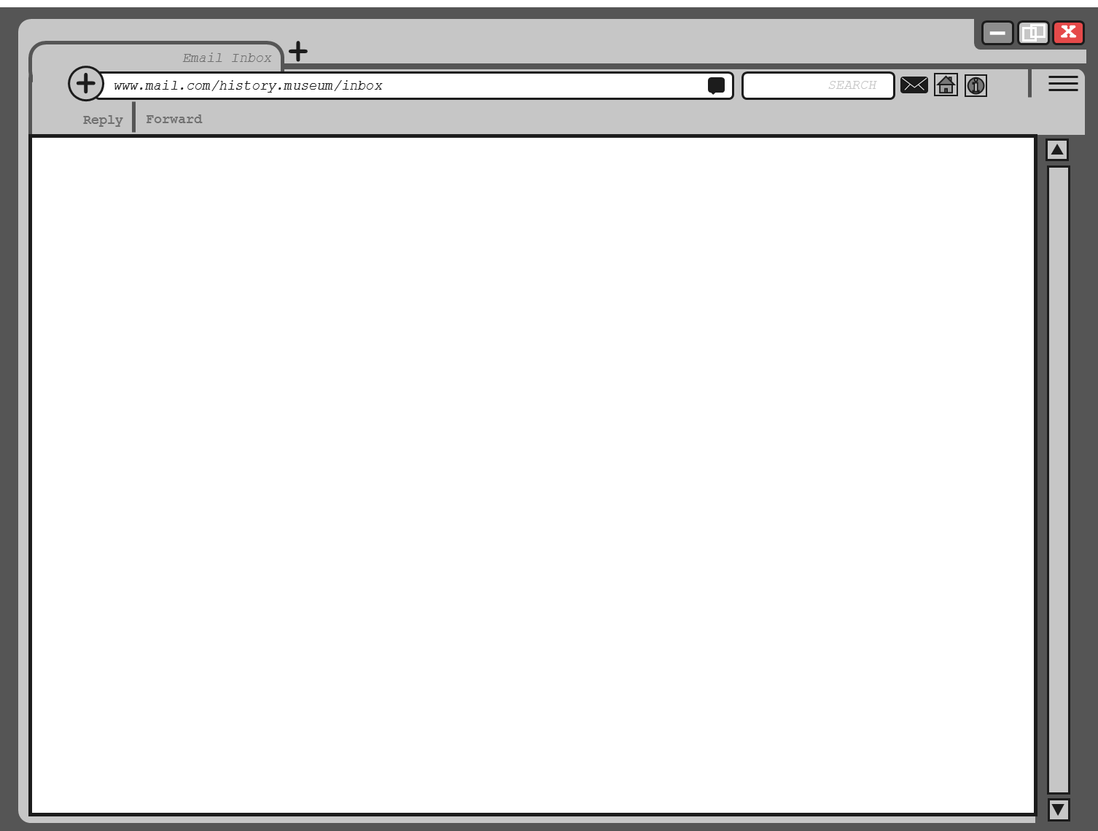
TO: Design Company
SUBJECT: Blazin’ Rasins Chocolate bar
We have been passed your details by Sir Bago Sugar. We need help with the design and marketing of our chocolate bar ‘Blazin’ Rasins’ and we would like your company to come up with:
A logo
A slogan
A packaging design
We have already formulated the recipe for the bar and the details of the product are as follows:
Ingredients: Bar 1: Dark chocolate and small chunks of popping candy. Bar 2: Milk chocolate and raisins.
Taste: Bar 1: Dark and tasting of cocoa but with the random ‘blazing’ effect of the pieces of popping candy. Bar 2: Smooth with the milk chocolate and fruity with the raisins.
Appearance: A single bar with an easily snappable plain chocolate ‘bridge’ connecting the two parts of the bar together. Bar 1 has ‘Blazin’ imprinted on it. Bar 2 has ‘Raisins’ imprinted on it.
Ways people have describe the war in focus group tests: unusual, wow, different, funky, eye popping, like a box of chocolates in a bar, fun.
Target market: Young people aged approximately 11 – 16 who have slightly outgrown ‘sweets’ but who still have a taste for ‘candy’.
We trust you will make a really professional job and would expect you to start by researching slogans, logos and packaging already in use by other chocolate bar manufacturers.
Thanks in advance – we look forward to seeing the results of your hard work.
The Blazin’ Rasins team

Slide 14
Choose a Project Manager
Who will take control of this task?
Who has an interest or skills that suit this type of task?
Who hasn’t been a Project Manager yet?
What lessons have we learned about the role from the previous task?

Slide 15
The Facts
Good branding can make a product instantly recognisable. Research shows that the Coca-Cola logo is recognised by 94% of the world’s population.
The founder of the social media site Facebook chose a blue colour for the brand because he is colour blind and can’t tell the difference between red and green.
Cadbury’s purple colouring has been used for over 100 years. It is a protected trademark.
Colour makes your brand stand out from competitors and can account for as much as 80% of choice.
Colours which work well together, and a simple design with the name of the chocolate bar clearly readable in the largest letters that fit on the bar is the formula followed by most ‘everyday’ chocolate manufacturers in Australia.

Slide 16


Research Links
Click on the text boxes below for research links.
Everyday chocolate bars
(scroll half way down to discover Australia’s top 10)
Exclusive chocolate bar wrapper designs
Another school’s designs (different project brief)
Notes:
Everyday chocolate bars: https://www.news.com.au/lifestyle/food/eat/australias-favourite-chocolate-bar-is-not-what-youd-expect/news-story/e84800646e30b3bcc7b6e25355f7f123
Exclusive design wrappers: http://story154.com/2016/07/27/food-trend-design-chocolate-bar-wrappers/
Another school’s designs: http://afaithfulattempt.blogspot.com/2012/02/chocolate-bar-wrapper-design.html

Slide 17

The Rules
Each team member completes a design sheet so the consistency of the brand can be established.
Finished designs will be displayed around the classroom.
Teams will be required to recite their chosen slogan together.
1st, 2nd and 3rd place will be decided by a secret ballot.
Team members cannot vote for their own designs.

Slide 18
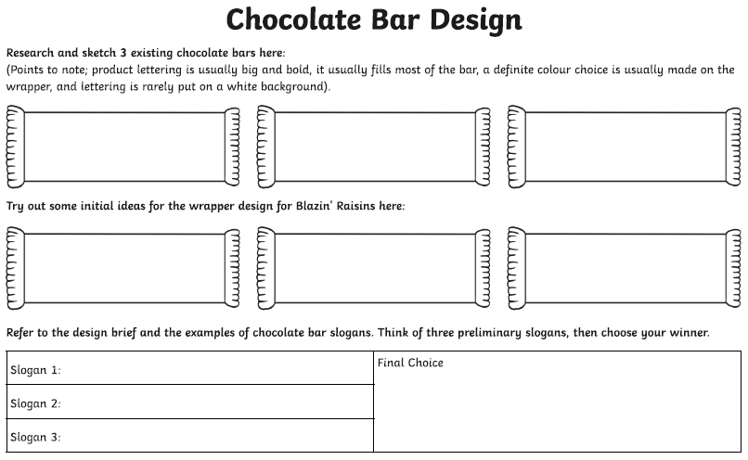
Design Time
Notes:
Research was included in the PowerPoint (no need for additional research)

Slide 19

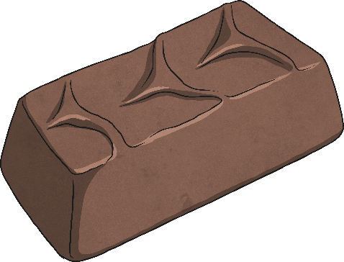

How to Choose Your Winner
Think about the unique nature of the product:
Which slogan and branding best reflects this?
Which have a ‘young’ enough feel?
Which slogans really stuck in your head?
Which packaging would be instantly recognisable in a shop?

Slide 20
Voting Time
Heads down, eyes closed and raise your hand to vote for your chosen winner. Your teacher will keep a record of the votes to establish 1st, 2nd and 3rd positions.

Slide 21
Lesson 3: Advertising Task
Some of the teams are taking a little while to warm up, but some of the work on that last task was good.
Advertising is the way to tell people about your product and for this task, you will need to come up with a campaign for a company who have invented a hoverboard. They have been in touch with some very specific requirements.
Over to you!

Slide 22
TO: Company responsible for the Blazin’ Raisins design, slogan and logo
SUBJECT: TV advert for the ‘No Bovver’ Hoverboard
Following your success with the design for the Blazin’ Raisins chocolate bar, we would like to bring you on board to manage the advertising campaign for our new product – the ‘No Bovver’ hoverboard. There has been a lot of money invested in this product which is at the cutting edge of new technology. The high cost of making the product combined with the cost of TV advertising means that the advert must deliver immediate interest and sales.
For this reason, we are looking for something a little different or ‘out of the box’. On the research links page there are links to adverts we have liked in the past, which may inspire your thinking.
There are also some product details below:
Product: No Bovver Hoverboard
Company producing the hoverboard: The Future is Here.
Product description: This hoverboard is the real thing – it has a range of 2 miles and can achieve heights of up to 30 metres. It has a flight time of up to 10 minutes. It works by creating its own magnetic field which repels the ground to keep it airborne.
Cost: At its launch the product will cost £999.99
Target market: This board is really aimed at anyone who can afford it, from middle-aged adults who remember hoverboards from Back to the Future to teenagers who are currently skaters. Therefore, the advert needs to appeal to a wide ranging audience.
Requirmenet: 1 x 30 second TV advert and 1 x billboard/magazine/newspaper advertisement (this will be scaled to suit the different formats).
Resources: Image packs containing an image of the hoverboard and a logo for the company ‘The Future is Now’ will be made available to you – these can be used at your discretion.
Good luck!

Slide 23
Choose a Project Manager
Who will take control of this task?
Who has an interest or skills that suit this type of task?
Who hasn’t been a Project Manager yet?
What lessons have we learned about the role from the previous task?

Slide 24
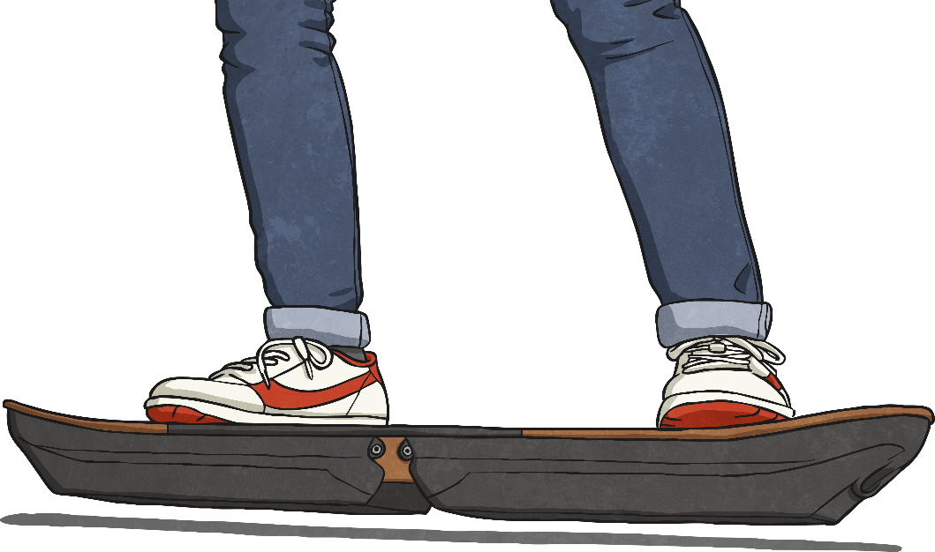
Research Links
Click on the bars below for research links.
Examples of print advertising posters
Examples of television advertising in the links below:
Sony Bravia
Turkish Airlines
Nike football
Cadbury’s - Eyebrows
Barclays Contactless
Notes:
Examples of print advertising posters: http://graphicdesignjunction.com/2012/09/50-fresh-examples-of-advertising-posters/
Sony: https://www.youtube.com/watch?v=0_bx8bnCoiU
Turkish Airlines: https://www.youtube.com/watch?v=NIy073bOKSA
Nike football: https://www.youtube.com/watch?v=7TeNlTgUU4M
Cadbury - eyebrows: https://www.youtube.com/watch?v=m58Bp6PfXss
Barclays Bank - Waterslide: https://www.youtube.com/watch?v=1WlRcXIO5ik
Library of TV Ads: http://www.tellyads.com/

Slide 25
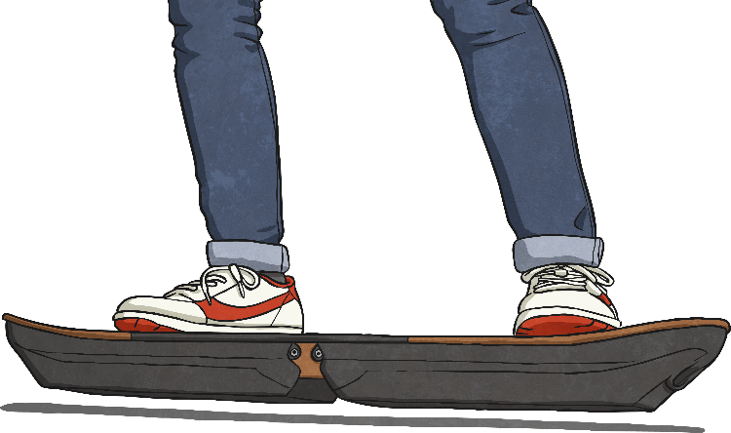
The Rules
Each team must complete a TV advert storyboard design sheet and a print advert design sheet.
Finished designs will be displayed around the classroom or group room.
Each team will then have an opportunity to talk through their advertising material to attempt to bring it to life for the audience. This may even include short sections of acting or voiceover.
First, second and third place will be decided by a secret ballot.
Team members cannot vote for their own designs.

Slide 26


Things to Remember: TV Advert
The audience/viewers need to know what is being sold – even if the advert is experimental, so don’t forget to start and end with the product name and slogan if appropriate.
Less is more – do you need to have pictures, captions, sound effects and music all at the same time?
Things to Remember: Print Advert
This advert will be used for everything from billboards to magazines and newspapers – be bold with logos and captions.
Link the poster to your TV advert by using a common theme or a still or image from the advert.

Slide 27
How to Choose Your Winner
Remember that the company producing the No Bovver Hoverboard wanted a different ‘experimental’ feel to the advert.
Who has best achieved this?
Which advertising campaign would get people talking?
Whose TV advert could you actually picture on the screen?
Did the team talk through every aspect of their idea?
Do the print poster and the TV advert link together somehow?

Slide 28
Voting Time
Heads down, eyes closed and raise your hand to vote for your chosen winner. Your teacher will keep a record of the votes to establish 1st, 2nd and 3rd positions.

Slide 29
Lesson 4: Invention Task
This is the ultimate test of your team’s business skills.
For this task, I want you to design a brand new product that meets a need in the market place.
You must make a prototype and ‘pitch’ your product to an audience. The winners will be the team who have the best idea and present it in the most engaging way.
There’s nowhere to hide on this task!

Slide 30

The Facts
It’s not something we need to think about often, but everything we use and depend on each day was invented by someone at some point.
Inventors turn nothing into something to make things easier for us, or to help use experience the world in a new way.
In 2018, almost
30 000 patent applications were received in Australia.
The following inventions commonly appear when lists of most important inventions ever are made – the wheel, the plough, the printing press, the combustion engine, the Internet.
Often things are invented by accident:
Potato chips were invented when a customer in the USA kept sending his hot chips back because they weren’t crunchy enough.
Play Doh was invented by brothers trying to invent a wallpaper cleaner.
Notes:
https://www.ipaustralia.gov.au/ip-report-2019-patents

Slide 31
Choose a Project Manager
Who will take control of this task?
Who has an interest or skills that suit this type of task?
Who hasn’t been a Project Manager yet?
What lessons have we learned about the role from the previous task?

Slide 32
The Rules
Some aspect of your design/invention must be innovative i.e. a Google search would not return any existing product which is exactly the same.
All members of the team must complete an Invention Task Planning Sheet.
All members of your team must contribute to the final ‘pitch’.
You must be prepared to answer questions at the end of your pitch.

Slide 33
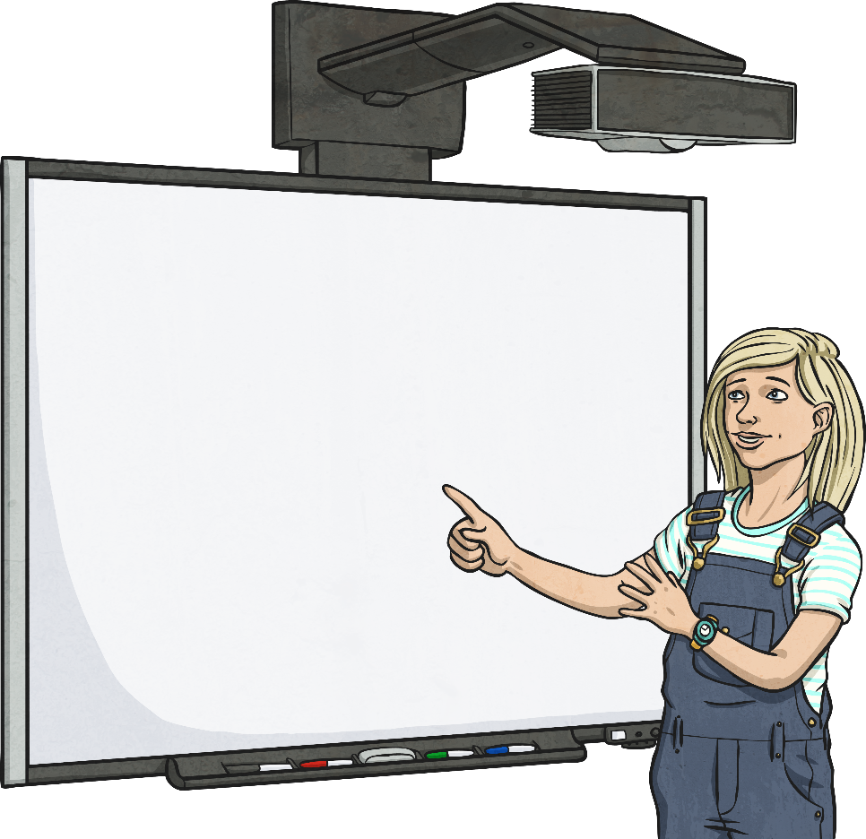

Research Links
Click on the bars below for research links.
Examples of inventions from 2014
Focus Groups (First 2 mins)
Example of a ‘pitch’ to promote and sell a product
Notes:
Examples of inventions from 2014: https://time.com/3594971/the-25-best-inventions-of-2014/
TedEdFocus Groups: https://www.youtube.com/watch?v=3TwgVQIZPsw
Pitch – Dragon’s Den - https://www.youtube.com/watch?v=-WzKghHe9zk

Slide 34
What You Should Do Next…
Think about any times you have needed to use something and you have been left thinking ‘This thing is not very good!’
Think about situations you have been aware of where the existence of a new object could have given you the help you needed.
Think about 2 or more things that are often used together – can they be combined into one handier object? (e.g. phones and cameras used to be separate!)
Is there are process currently done only on a large scale that could be shrunk down to be completed in a home or in a school? E.g. recycling machines?
Use the Complete the Invention Design Activity Sheet.
Start by sharing any ideas at all that you can come up within your group. At the early stages, no idea is too wild or crazy 0 ideas can inspire other ideas too.
Create a final list of three possible inventions from which to choose a final idea with the help of a focus group.

Slide 35

Focus Groups
Once you have your three ideas, you have reached the focus group stage. You may be blinded by the excitement of your own invention but what do the general public think?
Present a small group with your three ideas for an invention and get feedback on which idea people think is the best. (The focus group could be made up of children from another class or group or involve the adults in the room or elsewhere in the school or building). This will help you to decide which invention to use for this project.

Slide 36
Preparing for Your Pitch
Complete the Pitch Preparation Activity Sheet.
Underline or highlight anything really important so you don’t forget to say it.
Practise your pitch again and again until everyone knows what they are saying and can do it without notes. You can make cue cards if you need to.
Rehearse making eye contact with your audience.
If at all possible, make a prototype or a scale model of your invention that you can show the audience.
Remember to be excited and passionate about your invention – if you aren’t who will be?
Anticipate questions that you may be asked and have answers prepared in readiness.

Slide 37
It’s time to Pitch!
As you listen to the product pitches, using the
Design Pitch Scoring Sheet.
Score each team out of 10 on the following criteria:
Product: Do you understand their idea? Do you think it would work? Is it an original idea? How well do the team respond to questions about their product?
Presentation: How well do each team pitch their product? Are they confident? Can you hear them? Do they give eye contact? Is it well rehearsed and smooth? Are questions answered sensibly?
Passion: Do the team seem to believe in their product? Are they enthusiastic enough to make you believe in what they are doing?
After you have heard all of the pitches, add up the score for each team so you know who your winners are.

Slide 38

Voting Time
Heads down, eyes closed and raise your hand to vote for your chosen winner. Your teacher will keep a record of the votes to establish
1st, 2nd and 3rd positions.

Slide 39
Our Winners!
Congratulations!
You have shown huge business potential. You remind me of myself when I was at school.
You’re hired!

